Slide 1
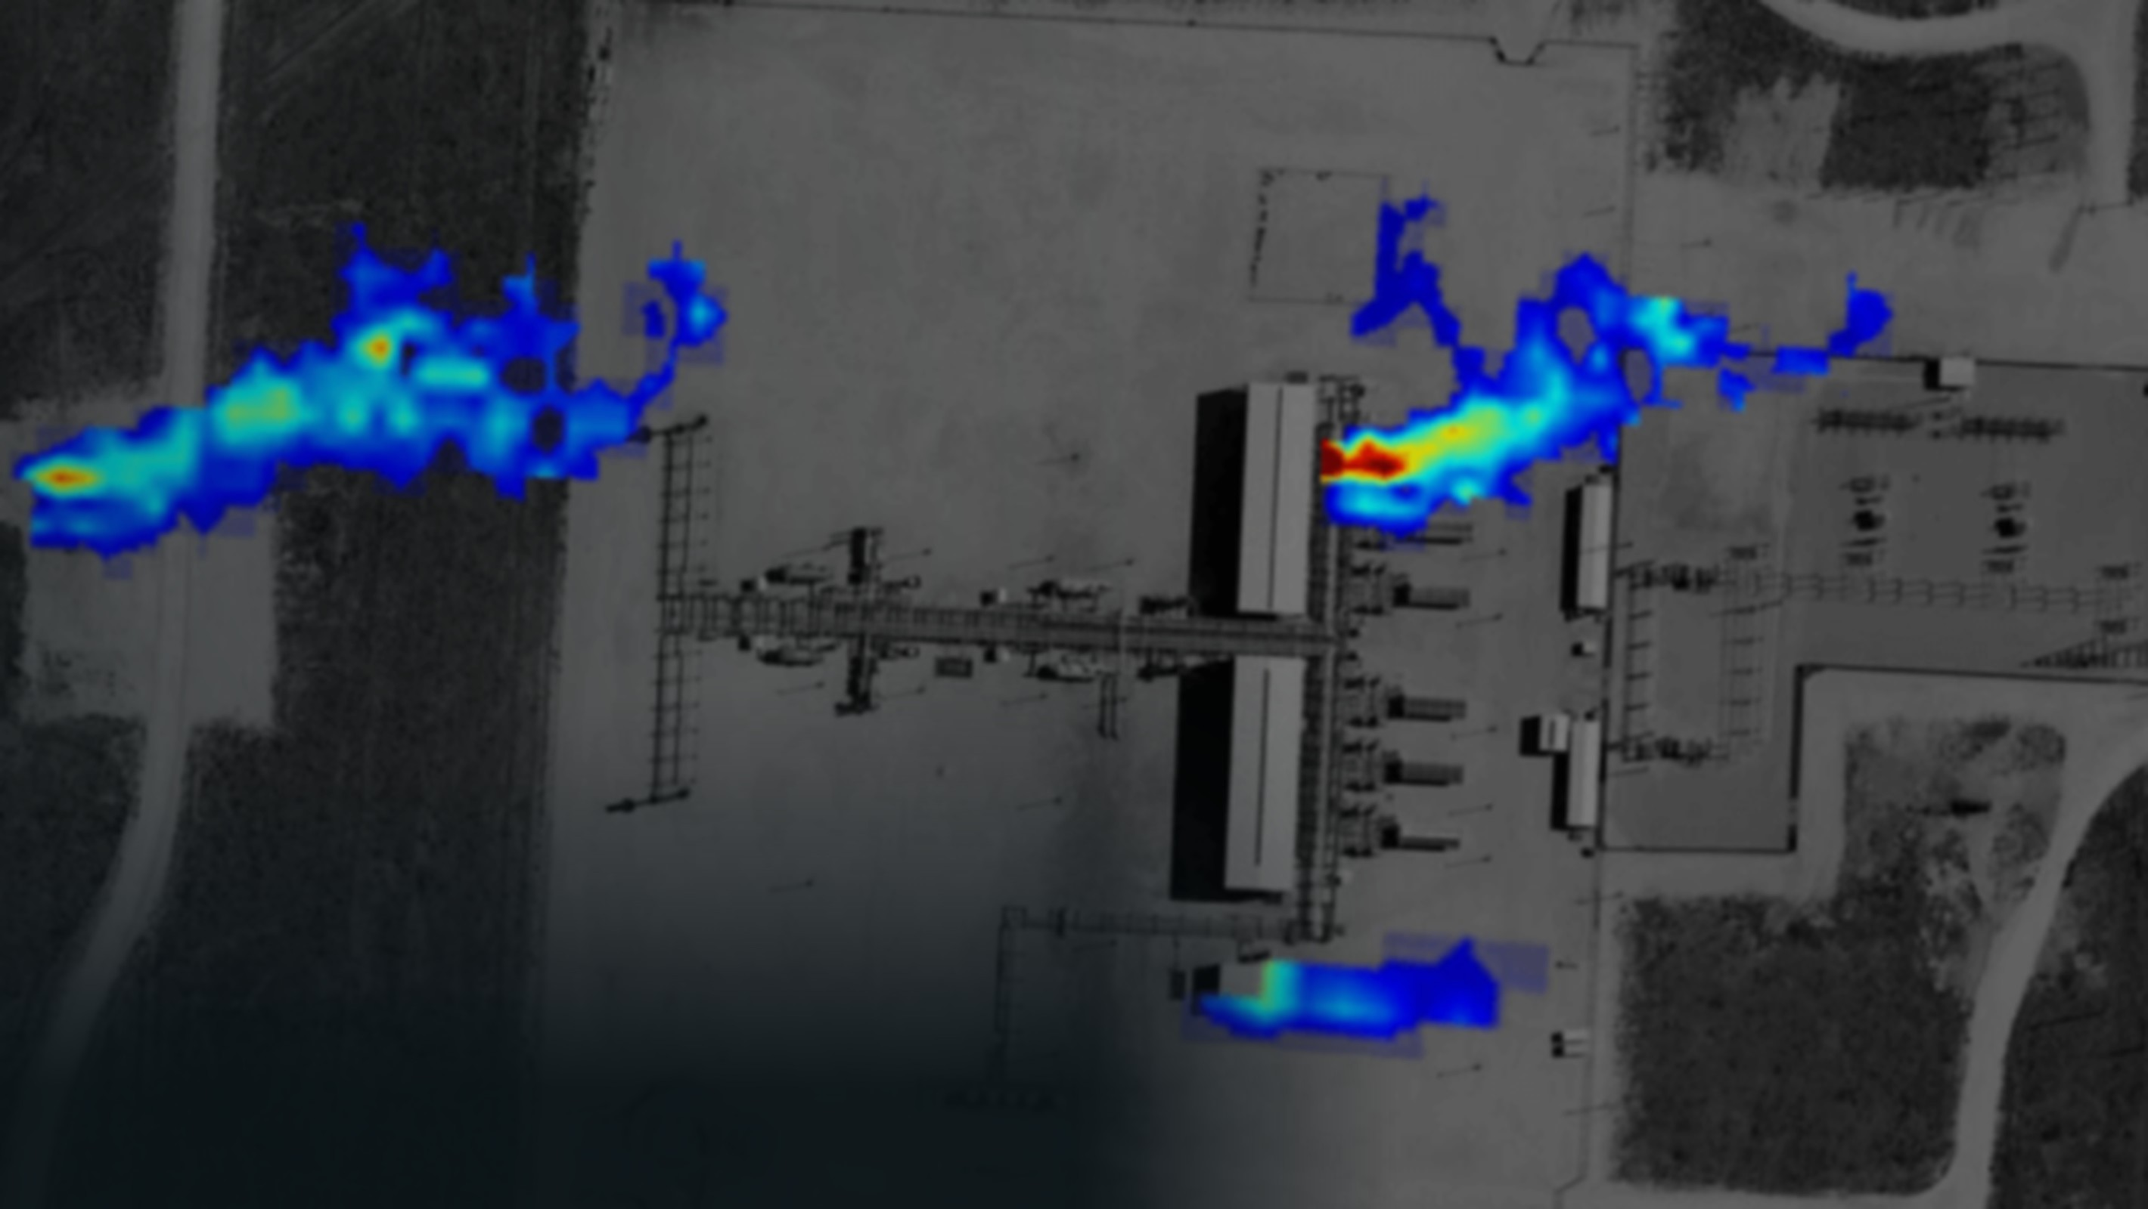


METHANE PLUME 1 · 0.93
PLUME 2 · 0.88
ATELIC EDGE ON DELL AI FACTORY
SOURCE TRACED
XV-2104 · K-201 discharge
EVERY METHANE LEAK, FOUND AND FIXED AT THE EDGE
PLUME 3 · 0.71
Agentic AI, live on Dell Edge. Come and ask it.
×
ADIPEC 2026, Abu Dhabi
Notes:
Cover and attract loop. Open with the picture: three methane plumes over a gas facility. Atelic has boxed every plume, scored its confidence and traced the biggest one to a single valve: XV-2104 on the K-201 compressor discharge. Line: "Your cameras can show you this. Our agents tell you which valve it is, how much it is costing you, and what to do about it, all on a Dell server at the site." Then go to the story slide. Before the show: confirm the image licence and add its credit.

Slide 2






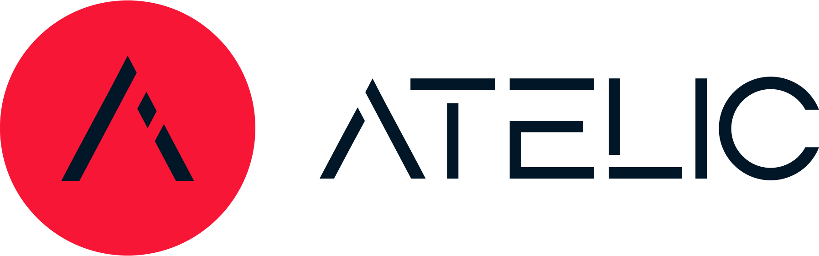

ATELIC EDGE ON DELL AI FACTORY · OIL & GAS
METHANE LEAK TO FIX IN MINUTES, NOT DAYS
Detection is solved. Closing the loop isn't. Alarm to fix, fully on a Dell Edge at the site.
YOUR CAMERAS
WHERE ATELIC CLOSES THE LOOP
T+0 s
T+40 s
T+2 min
T+5 min
T+8 min
T+10 min
1
Detect
2
Locate
3
Quantify
4
Plan
5
Approve
6
Report
Uses your existing gas cameras. Vision agent confirms the plume.
Graph agent traces it to valve XV-2104 on compressor K-201.
Emissions agent estimates the leak rate from measured data.
Maintenance agent drafts the isolation plan, work order and permit.
The control-room engineer reviews the evidence and approves.
Compliance agent files an OGMP 2.0-aligned record with audit trail.
Your cameras + NVIDIA VSS
Atelic graph + NeMo Retriever
Atelic agent on NVIDIA NIM
Agentic RAG + Nemotron NIM
NeMo Guardrails + human
Atelic agent + audit log
Step 1 uses the cameras you already own. Steps 2–6 are where Atelic closes the loop.
×
ADIPEC 2026, Abu Dhabi
02
Notes:
Talk track (about 90 seconds). Everyone at ADIPEC is showing a drilling copilot. We are showing something every operator deals with every day: methane. This is the Emissions Management use case from the Dell AI Factory for Energy, built and running. Key line: detection is solved. Your gas camera vendor can already tell you there is a plume. What nobody does is close the loop: which valve, how much, what to do, who approves, and the compliance record. That is steps 2 to 6, and that is Atelic. Detect: we plug into the gas cameras the site already owns; we partner with camera vendors, we do not compete with them. The vision agent runs on the NVIDIA Video Search and Summarization blueprint and cross-checks detectors and DCS trends. Locate: the Atelic knowledge graph knows which valve sits on which line, upstream of which compressor. Quantify: a measured, uncertainty-bounded rate, as OGMP 2.0 Level 4 and 5 reporting asks for. Plan and Approve: agentic RAG with a Nemotron reasoning model drafts the isolation and work order; NeMo Guardrails stop any action on plant equipment until a human approves. Report: the compliance record is written automatically with every source cited. Times and tags are illustrative for the demo.

Slide 3
INSIDE THE BOX
THE DELL AI FACTORY STACK, ON ONE RUGGED SERVER
Atelic adds plant knowledge, OT connectors and agents on top.
SITE DATA
ONE EDGE NODE AT THE SITE
ACTIONS
DCS / SCADA tags (OPC UA)
ATELIC
Control-room alert with evidence
Agent team
Plant knowledge graph
Existing gas cameras and detectors
Vision, graph, emissions, maintenance, compliance
Assets, tags, P&IDs, history + OT connectors
Work order and permit draft
Flare and flow meters
NVIDIA AI ENTERPRISE
OGMP 2.0 emissions record
NIM · Nemotron + vision
Maintenance history (CMMS)
Speech NIM · Arabic + English
NeMo Retriever
Spoken answers: "Ask the plant"
P&IDs, procedures, manuals
NeMo Guardrails
VSS video blueprint
DELL POWEREDGE XR7620
Rugged edge server with GPUs
DELL NATIVE EDGE
Zero-touch rollout to every site
×
ADIPEC 2026, Abu Dhabi
03
Notes:
Talk track (about 90 seconds). Left: the data the site already has. We connect to the DCS or SCADA over standard protocols such as OPC UA, plus existing gas cameras, detectors, meters, the CMMS and the engineering documents. Centre, from the bottom up. Dell NativeEdge deploys and manages the whole stack, zero-touch, across every site. Dell PowerEdge XR7620 is the rugged edge server at the site. NVIDIA AI Enterprise provides the building blocks: NIM for reasoning and vision models, Speech NIM for Arabic and English voice, NeMo Retriever for document search, NeMo Guardrails for action safety, and the Video Search and Summarization blueprint for camera feeds. On top, Atelic: the plant knowledge graph with OT connectors, and the agent team. This is the part that makes generic AI building blocks understand a gas plant. Right: what comes out is not a dashboard, it is work done. Why the edge: data sovereignty is a board-level topic in this region, remote sites have poor connectivity, and you do not want a cloud round trip between seeing a leak and acting on it.

Slide 4

LIVE AT THE BOOTH
TALK TO THE PLANT. WATCH THE AGENTS THINK.
Two screens, live on the Dell Power Edge. Questions no gas camera can answer.
HERO MOMENT
ALWAYS-ON SCREEN
Ask the plant, in Arabic or English
The glass box
لماذا يتسرب الضاغط K-201، وماذا حدث في المرة الماضية؟
00:00.4
Vision
plume found, camera 3
"Why is K-201 leaking, and what happened last time?"
00:01.1
Graph
P&ID path to XV-2104
00:02.0
Emissions
leak rate estimated
1
Speak
2
Graph walk
3
Answer
Speech NIM transcribes Arabic or English
The path lights up on the P&ID
Spoken reply, every source cited
00:03.2
Maint.
procedure retrieved
00:03.5
Guardrail
valve action held
GPU load · Dell XR
Example answer: "Packing failure on valve XV-2104. The same packing was replaced 14 months ago. Recommended: isolate, re-pack, upgrade to low-emission packing."
Every hand-off, tool call, source and guardrail decision, live.
×
ADIPEC 2026, Abu Dhabi
04
Notes:
How to run the booth (about 60 seconds to introduce, then hand over). Hero moment, left screen: this is the moment that shows the difference from camera vendors. A camera sees a plume; only the plant knowledge graph knows what that valve is, what it connects to and what happened to it last time. Invite a visitor to the mic. They ask a question in Arabic or English. Speech NIM transcribes it locally. The Atelic graph agent walks the plant knowledge graph and the path lights up on the P&ID. The answer comes back on screen and spoken, with every source cited. Starter questions: "Why is K-201 leaking, and what happened last time?" "Which other valves of this type are on site?" "What permit do I need to isolate it?" Glass box, right screen: always on. It shows each agent hand-off, the tools and data each agent touched, the guardrail decisions, and GPU load on the Dell server. Note for the team: Arabic speech recognition is listed in the NVIDIA Speech NIM support matrix. Confirm the Arabic voice reply before the show; if it is not available, reply in Arabic text on screen with an English voice.

